Slide 1

BANKER’S ALGORITHM
Group members
Sudanshi Sehgal (2021A1R156)
Souhani Gandotra (2021A1R167)
Simrat Singh (2021A1R170)
Anjali Salaria (2021A1R181)

Slide 2
Problem Statement:-
To implement the most representative banker’s algorithm for deadlock avoidance

Slide 3
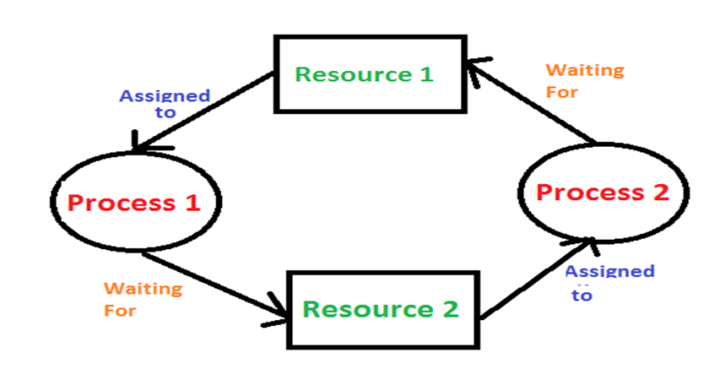
What is Deadlock?
Deadlock is a situation where a set of processes are blocked because each process is holding a resource and waiting for another resource acquired by some other process.

Slide 4
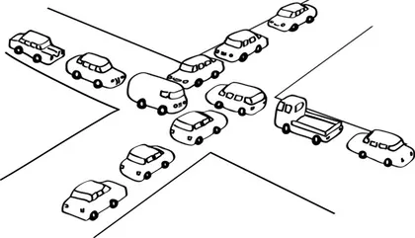
A Real-World Example
A real world example would be traffic, which is going only in one direction.
Here, a bridge is considered a resource.
So, when Deadlock happens, it can be easily resolved if one car backs up.
Several cars may have to be backed up if a deadlock situation occurs.
So starvation is possible.

Slide 5

The Conditions for Deadlock
Deadlock can arise if the following four conditions hold simultaneously (Necessary Conditions)
1. Mutual Exclusion:
Only one process at a time may use a shared resource (i.e. critical section).
2. Hold and wait:
A process may hold allocated resources while awaiting assignment of others.
3. No pre-emption:
A resource can be released only voluntarily by the process holding it, after that process holding it, after that process has completed its task
4. Circular Wait:
A closed chain of processes exists, such that each process holds at least one resource needed by the next process in the chain.

Slide 6

The Conditions for Deadlock
Deadlock occurs if and only if the circular wait condition is unresolvable
The circular wait condition is unresolvable if the first 3 policy condition hold
So the 4 conditions taken together constitute necessary and sufficient conditions for deadlock

Slide 7
Requirements
Banker’s Algorithm
Linux Operating System
Coding Platforms:
Nano editor / vi editor

Slide 8
Banker’s Algorithm
Banker’s Algorithm is resource allocation and deadlock avoidance algorithm which test all the request made by processes for resource, it checks for the safe state, if after granting request system remains in the safe state it allows the request and if there is no safe state it does not allow the request made by the process.
Inputs to Banker’s Algorithm:
Max need of resources by each process.
Currently, allocated resources by each process.
Max free available resources in the system.
The request will only be granted under the below condition:
If the request made by the process is less than equal to max need to that process.
If the request made by the process is less than equal to the freely available resource in the system.

Slide 9
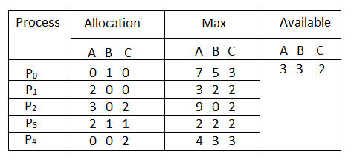
Example of Banker’s Algorithm
Example: Considering a system with five processes P₀ through P₄ and three resources of type A, B, C. Resource type A has 10 instances, B has 5 instances and type C has 7 instances.

Slide 10
Example (contd.)
Need = Max- Allocation
Need
A B C
P0 7 4 3
P1 1 2 2
P2 6 0 0
P3 0 1 1
P4 4 3 1
The system is in a safe state since the sequence < P1, P3, P4, P2, P0> satisfies criteria.

Slide 11
Now P1 requests (1,2,2)
Check that Request <= Available
(that is, (1,2,2)<=(3,3,2)) is true
Allocation Need Available
A B C A B C A B C
P0 0 1 0 7 4 3 2 3 0
P1 3 0 2 0 2 0
P2 3 0 2 6 0 0
P3 2 1 1 0 1 1
P4 0 0 2 4 3 1

Slide 12
Pseudo Code:- A safe sequence of processes, or an empty sequence if no such sequence exists.
1.while there exists a process P in N that has not been terminated do
2.if there exists a resource R in M that P can request and be granted without causing a deadlock then
3.request R from P
4.else if P can release a resource R without causing a deadlock then
5.release R from P
6.else
7.wait
8.end if
9.end while
10.return the safe sequence

Slide 13
Algorithm:
Safety Algorithm
1) Let Work and Finish be Arrays of length ‘m’ and ‘n’ respectively.
Initialize: Work = Available
Finish[i] = false; for i=1, 2, 3, 4….n
2) Find an i such that both
a) Finish[i] = false
b) Need i <= Work
if no such i exists go to step (4)
3) Work = Work + Allocation[i]
Finish[i] = true
Go to step (2)
4) if Finish [i] = true for all i
then the system is in a safe state

Slide 14
Algorithm:
Request Algorithm
1) If Request i <= Need i
Go to step (2) ; otherwise, raise an error condition, since the process has exceeded its maximum claim.
2) If Request i <= Available
Go to step (3); otherwise, Pi must wait, since the resources are not available.
3) Have the system pretend to have allocated the requested resources to process Pi by modifying the state as
follows:
Available = Available – Request i
Allocation i = Allocation i + Request i
Need i = Need i– Request i

Slide 15
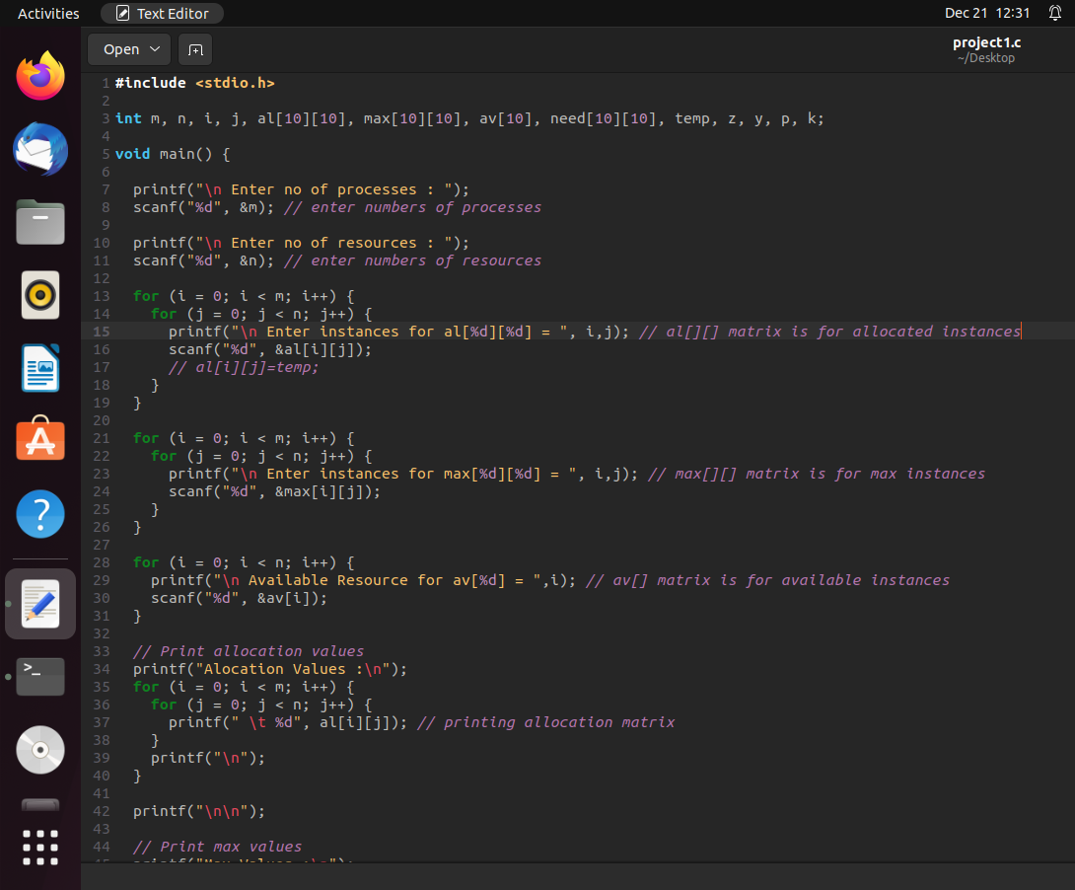
TECHNICAL DETAILS (CODING)

Slide 16
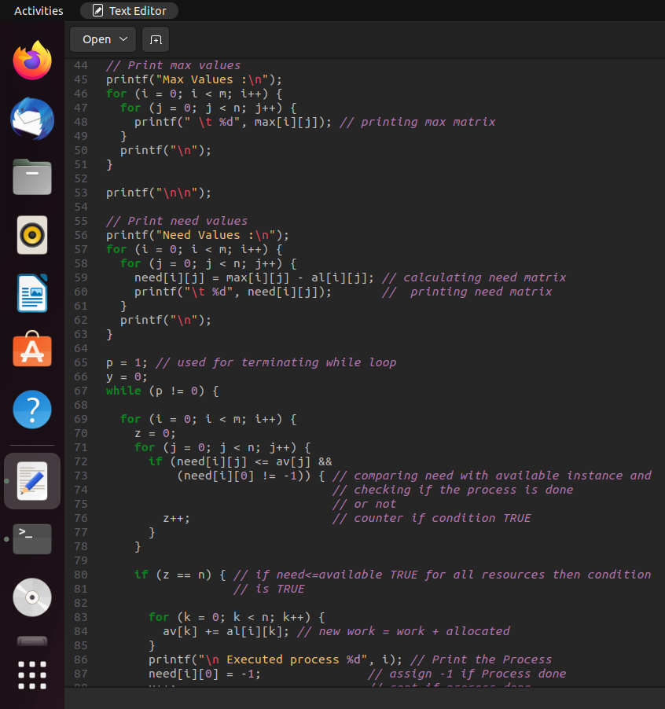

Slide 17
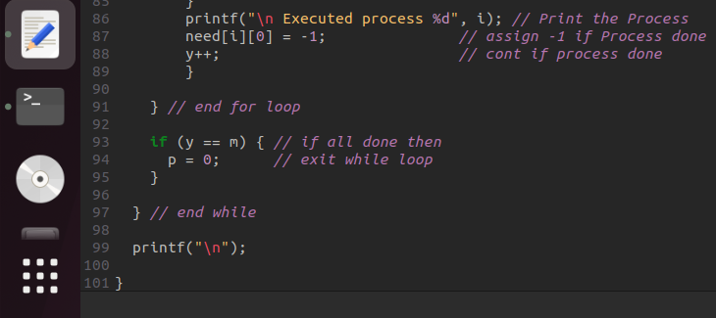

Slide 18
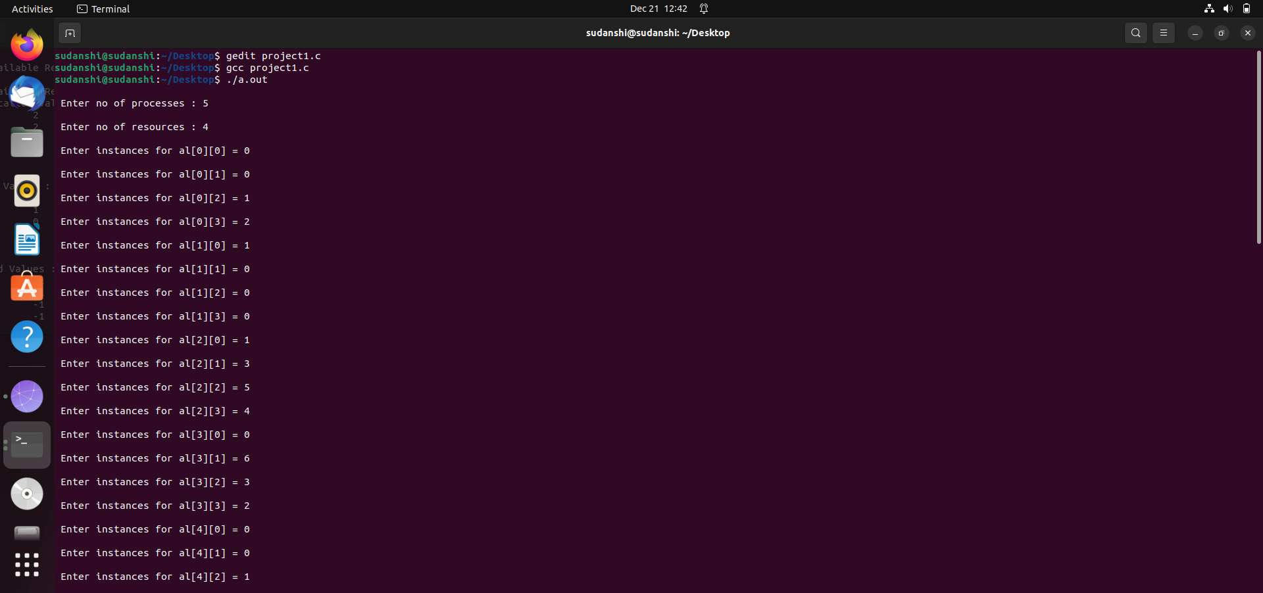
OUTPUT
NO DEADLOCK

Slide 19
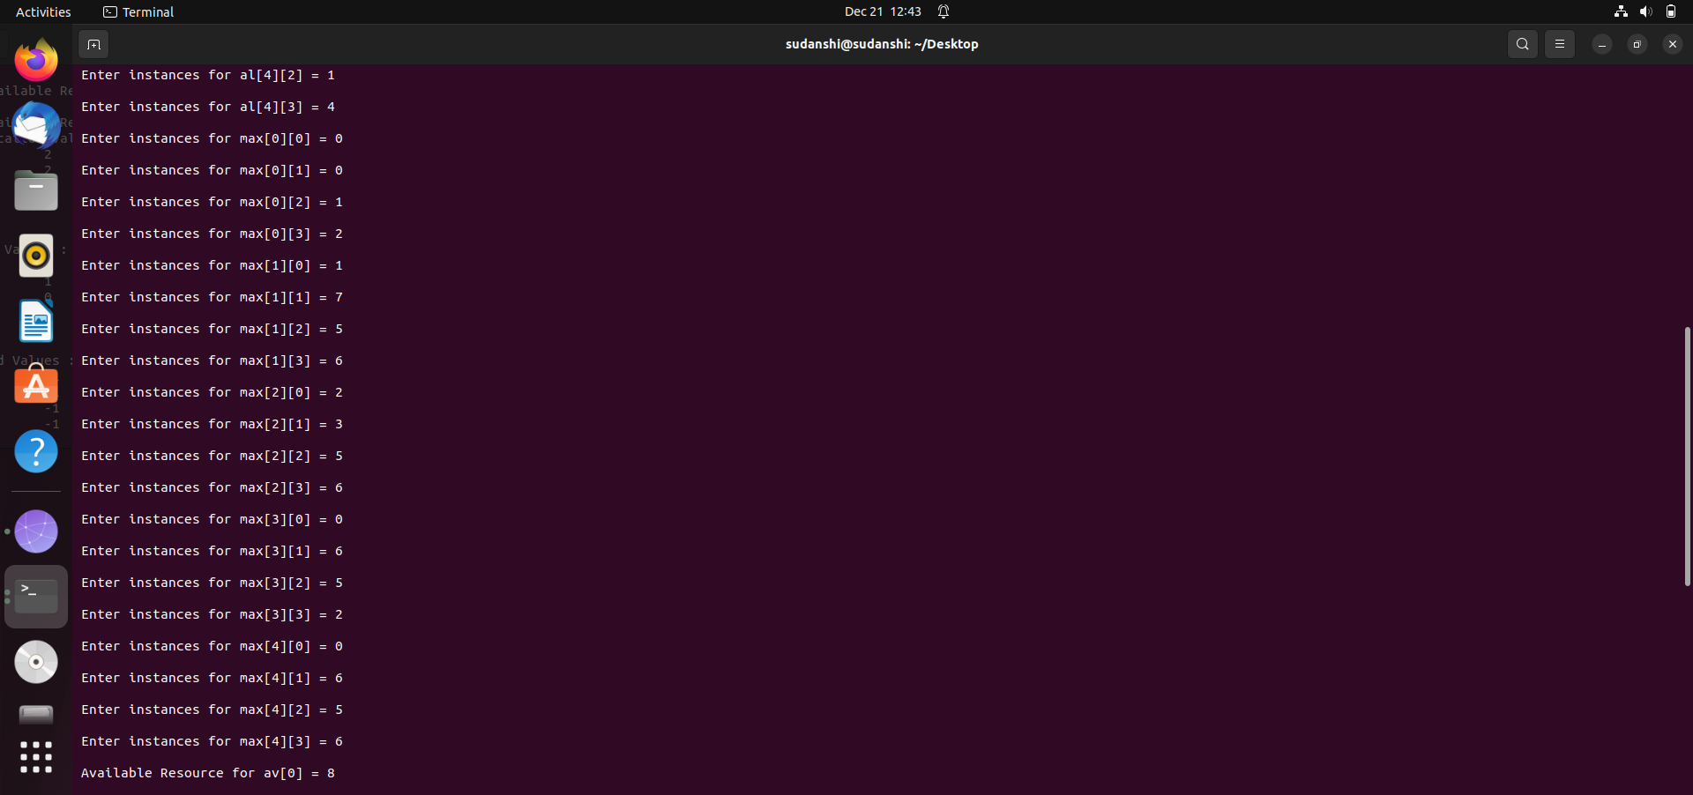

Slide 20
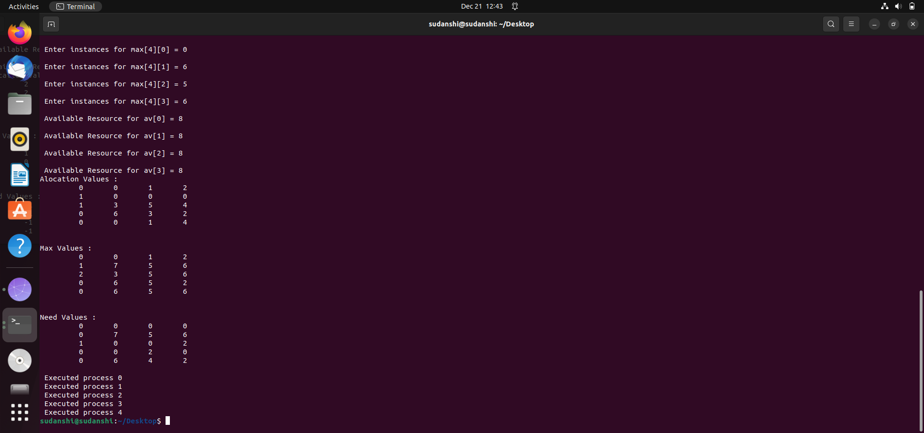

Slide 21
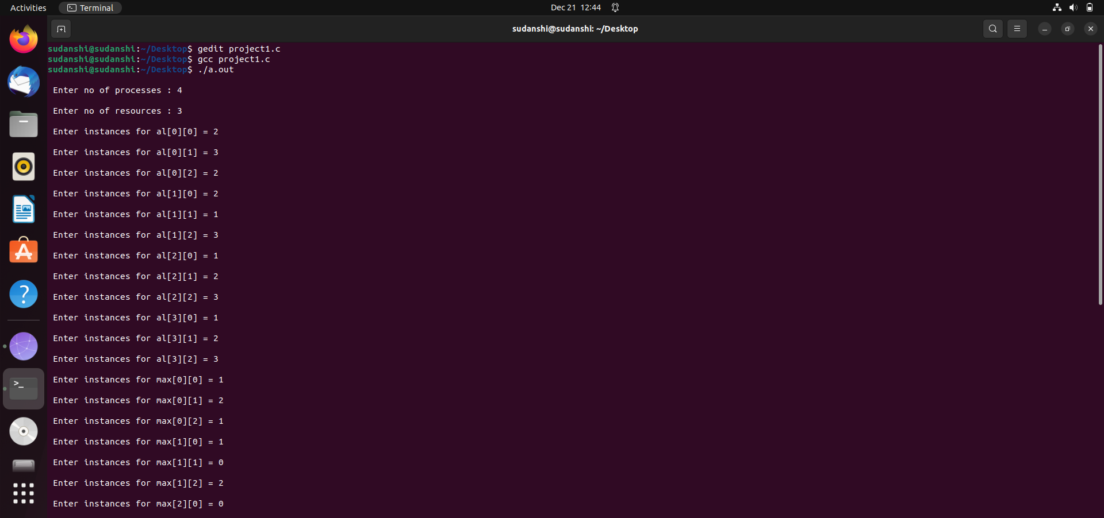
OUTPUT
DEADLOCK

Slide 22
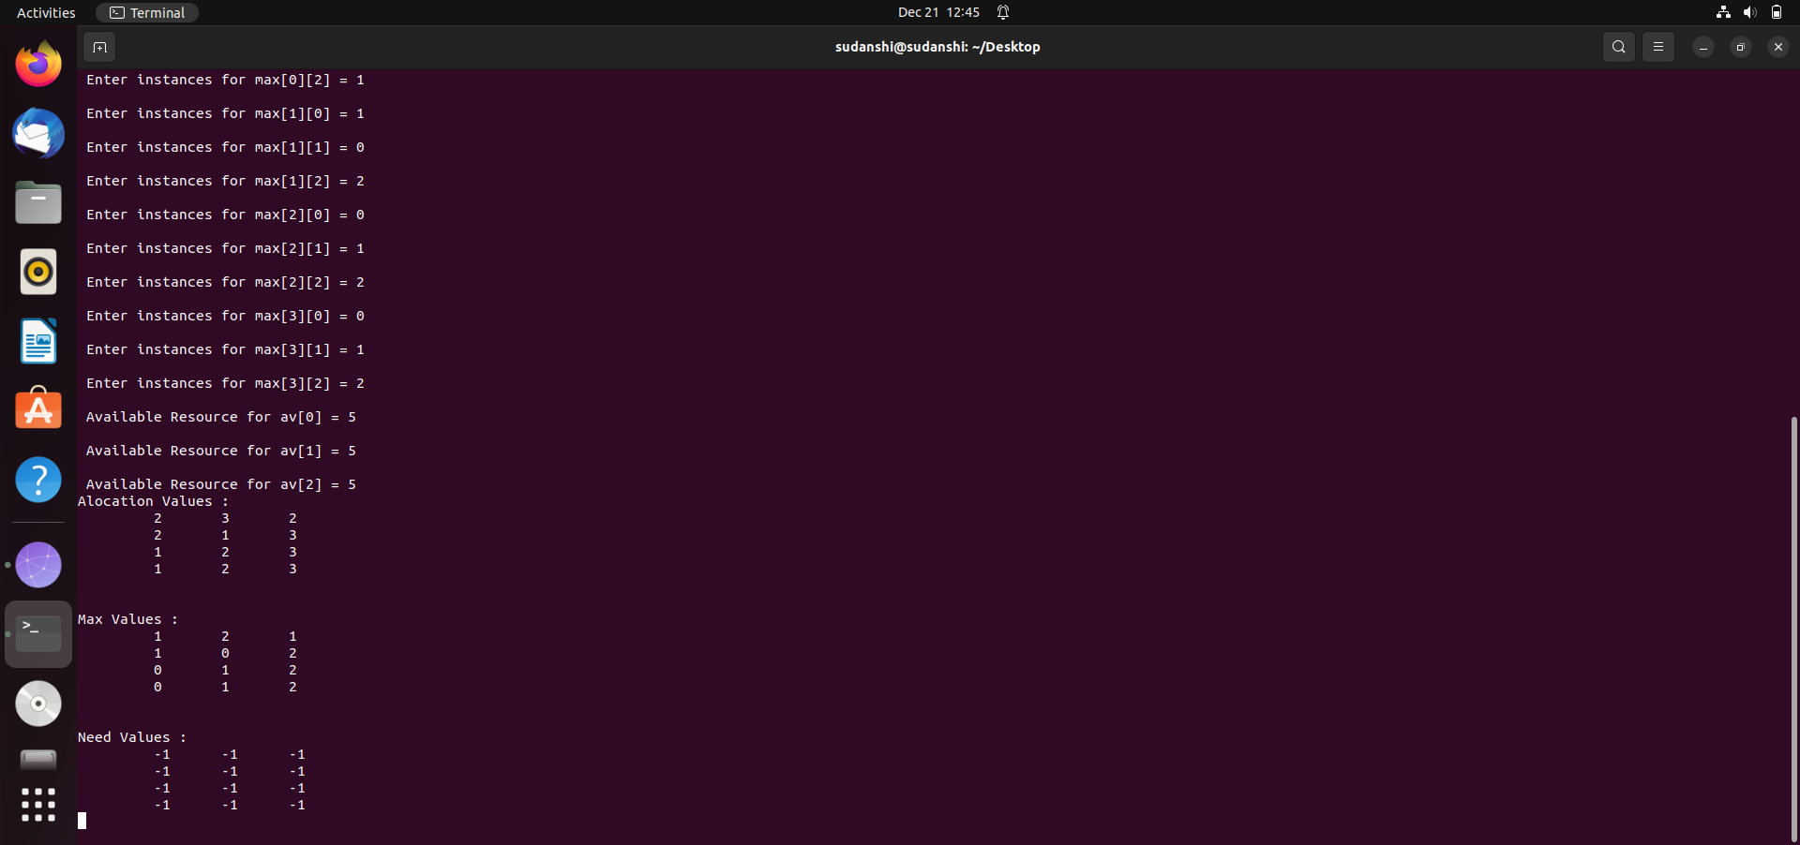

Slide 23

THANK YOU

